Slide 1
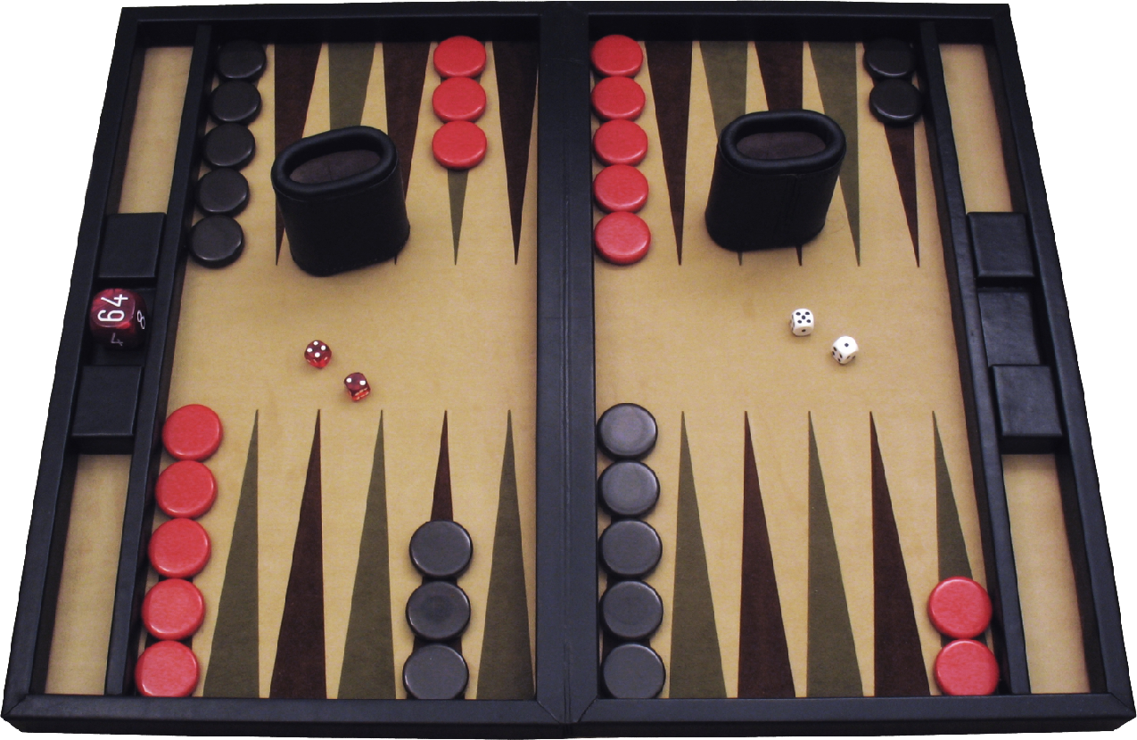
Backgammon 4 Real
Play Backgammon against the computer on a real board
Oz Mishli & Or Hayat
Introduction to Computational and Biological Vision 2021
Department of Computer Science, Ben-Gurion University

Slide 2
Project Goals
Play Backgammon vs. an AI-powered computer rival
Using a real Backgammon board and checkers
Very good user experience
A system that would be easy to set up, with standard components

Slide 3
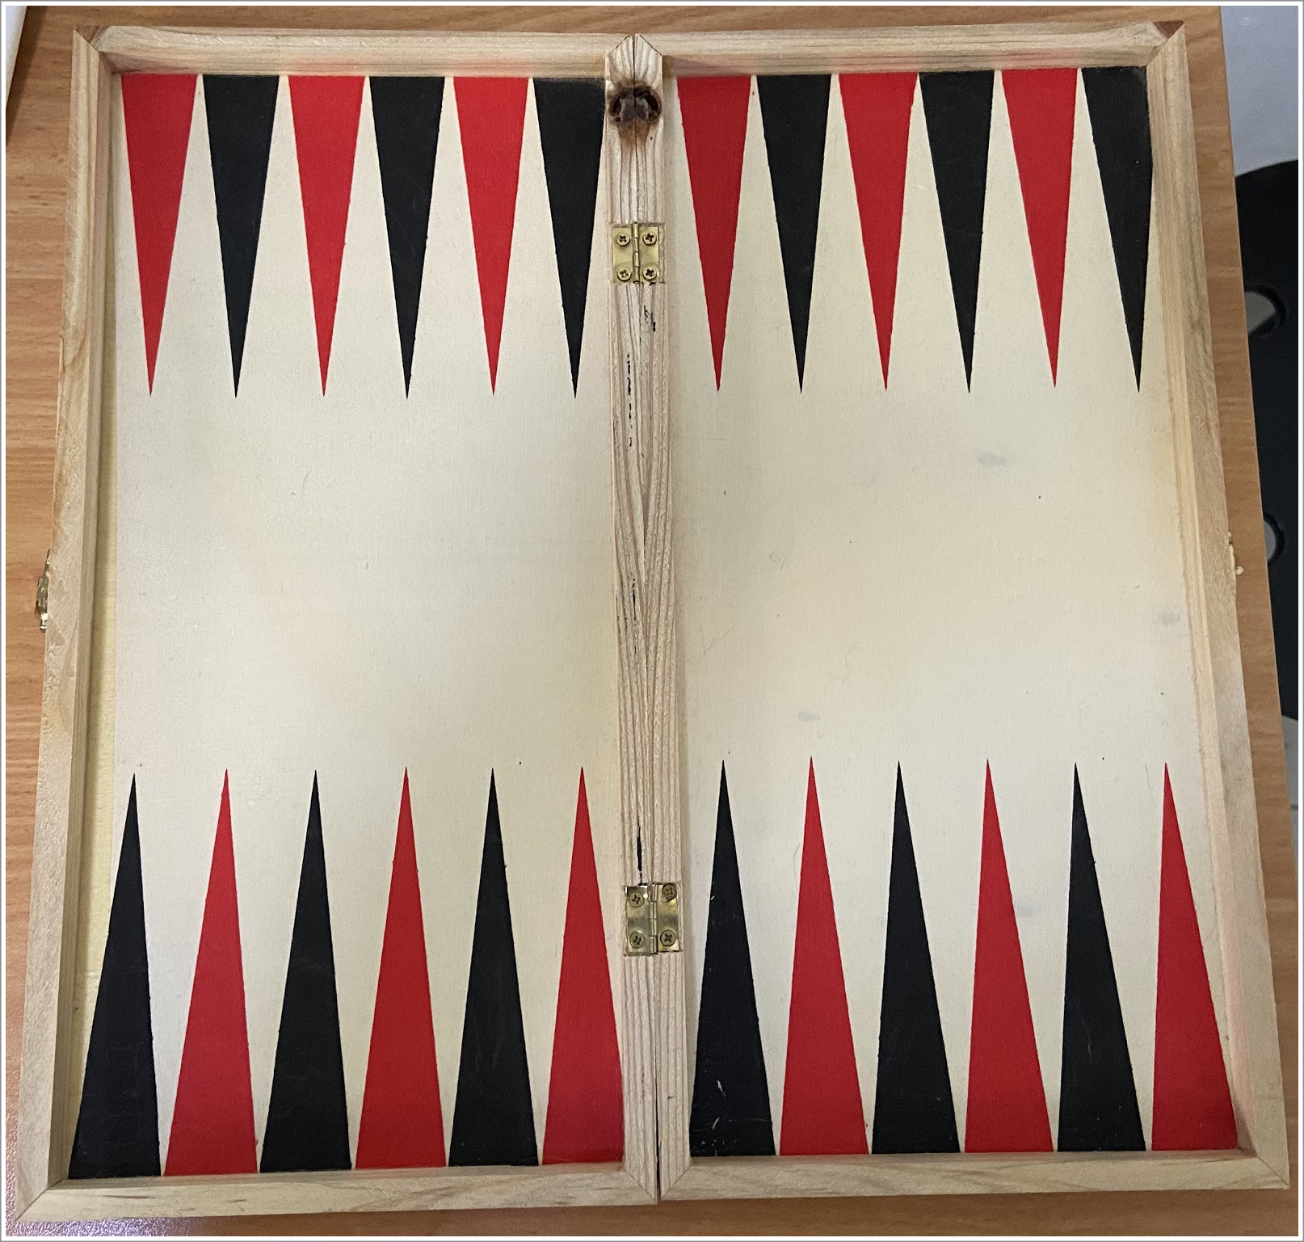
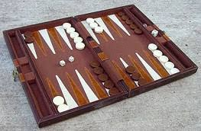
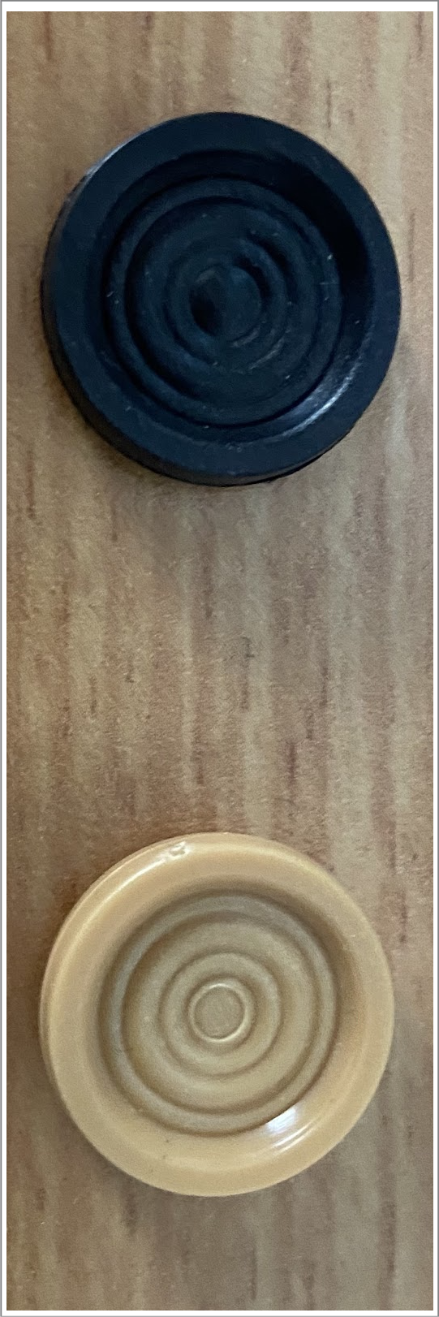
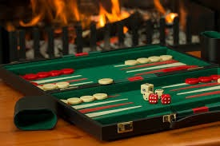
Huge variety of colors and board types

Slide 4
Design Principles
Standard laptop and USB-webcam
Backgammon board on the table
Board must be fully acquired by the image
Automated and seamless board/camera calibration
Smooth user experience

Slide 5


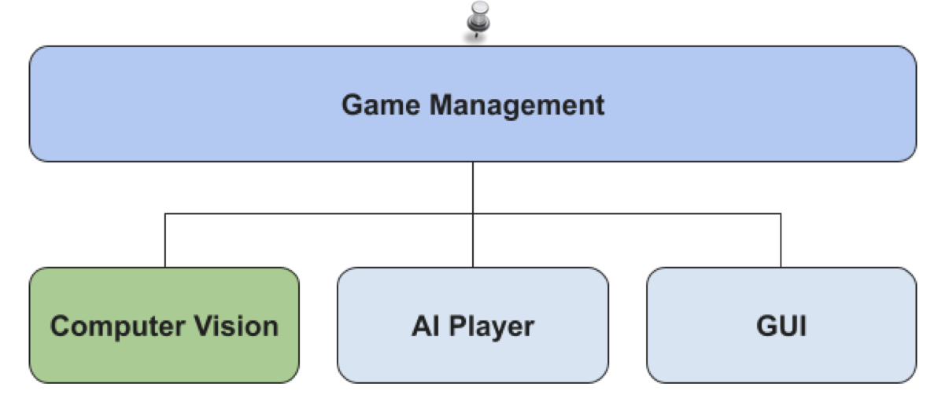






System Design
Developed on top of Open AI Gym
Developed from scratch
OpenAI Gym

Slide 6
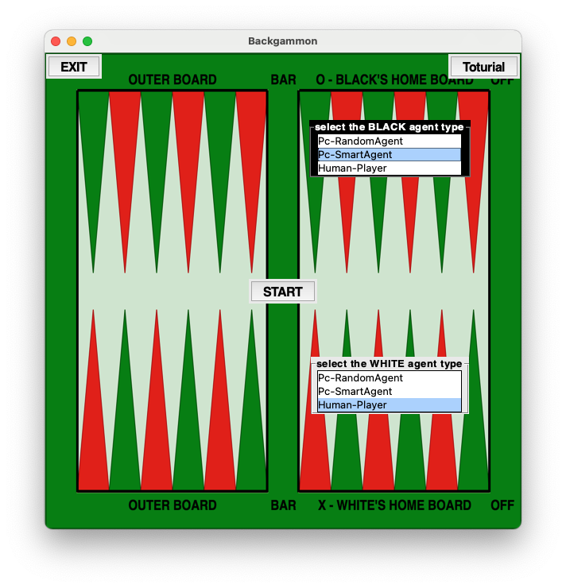
GUI & AI Player
Built using Python Tkinter library
Multiple adaptations done for the project
The game takes place on the real board, captured during the game
Player is moving both checkers (human and PC)
PC moves are broken to one by one: easier to follow by the player
Dice roll is virtual for both players — for smoothness
Semi automated: need to confirm after move

Slide 7


Computer Vision Module: Challenges
Checkers cover important visual features of the board during the game (e.g. triangles)
Many small checkers (30), freely moving with no fixed locations on the board
The board is not smooth, its color is not distinctive
Black checkers color is identical to the black triangles
Chosen a “stateful board capturing” approach

Slide 8
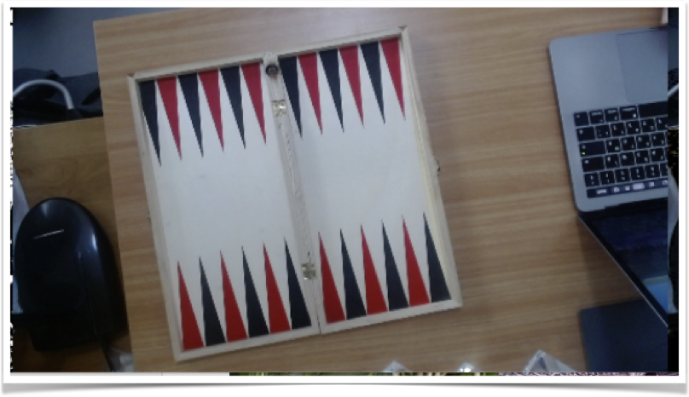

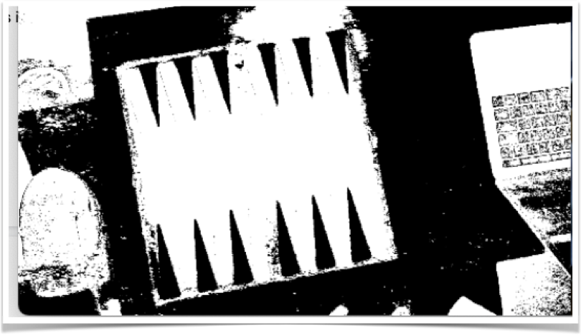
Board Detection, Take #1
Requirements
Needs to be highly accurate
Needs to include alignment of the board
Must not rely on visual features of the board (covered during the game)
Challenges
Colors issue — cannot effectively distinct the board from it’s surrounding
Spent days on this, in vain 😟

Slide 9
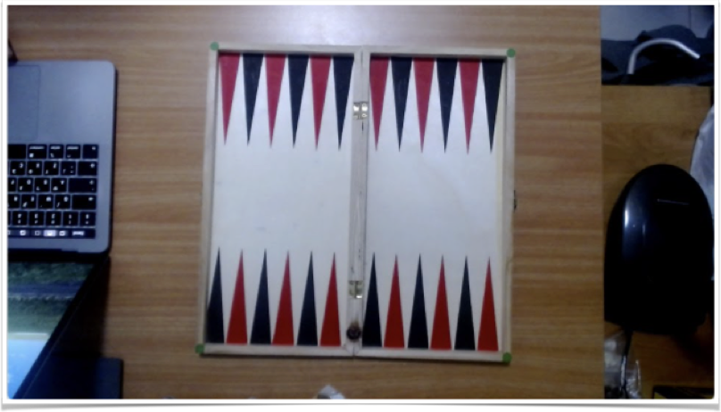

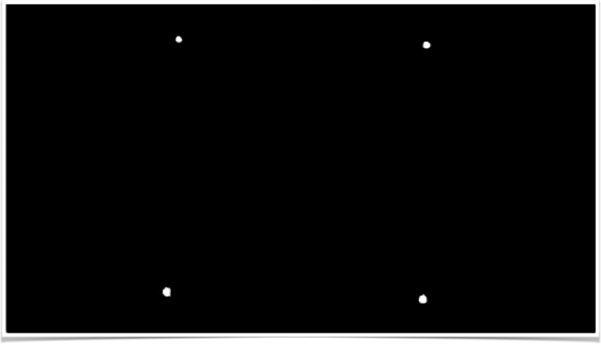
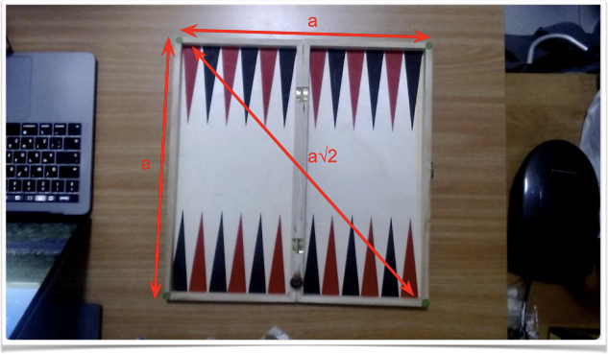

Board Detection, Take #2
Added 4 circle-shaped green staples on the board’s vertices
Detection:
Green HSV filter
Erosion and dilation
Hough circle transform
(Optional) geometric verification, with some slack for camera angle flexibility

Slide 10
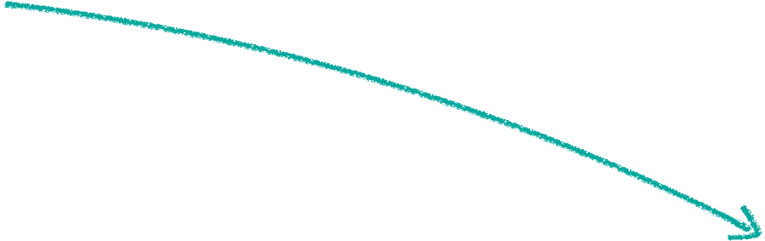
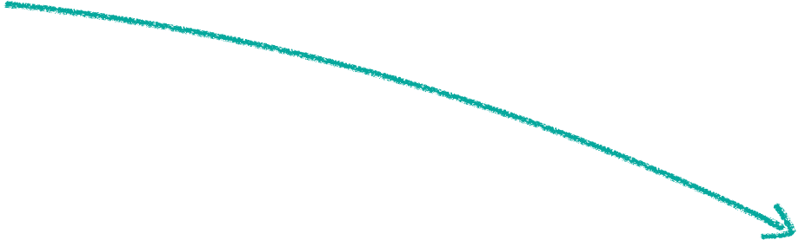
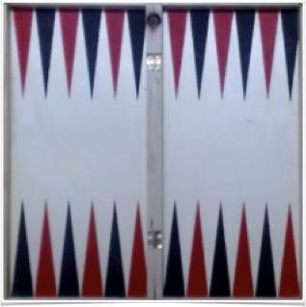

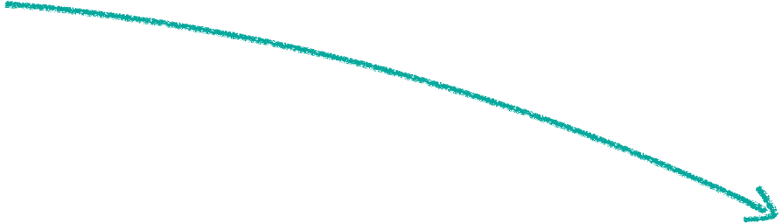
Board Alignment using Homography
Homography
Original image to 400x400 tightly cropped and aligned board

Slide 11
Board Calibration: Goals
Find all areas on the board where checkers can “legally” be placed
Define them numerically on the tightly cropped board image: Checkers Containers
Automatic process with no user intervention
Done once, before the game starts; on an empty board
During the game, detect the location of checkers and associate them to containers

Slide 12
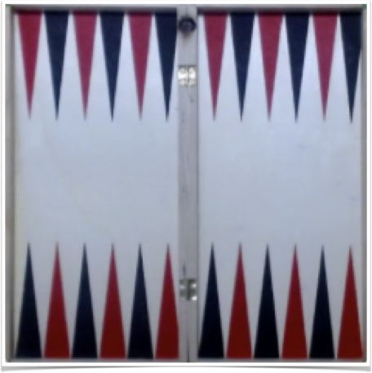
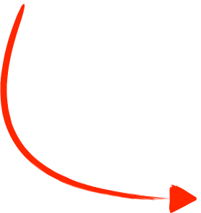
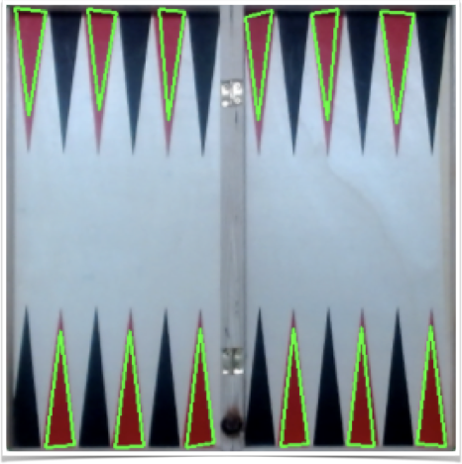
Calibration Step #1
The red triangles are most distinct in color and shape
Triangle Detection:
Gaussian blur
Red HSV filter
Filter all contours with 3 edges
Filter triangles with ratio 1:4.5 base to edges

Slide 13
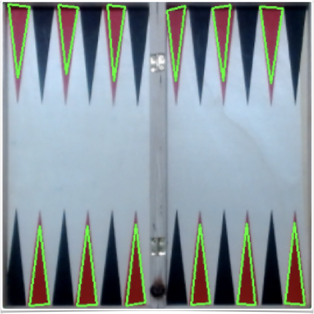

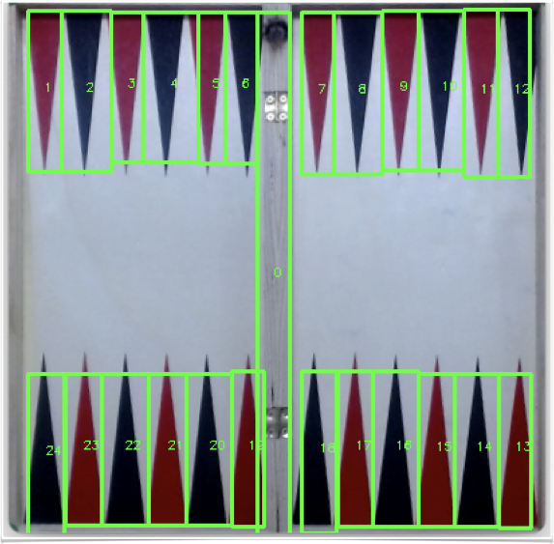
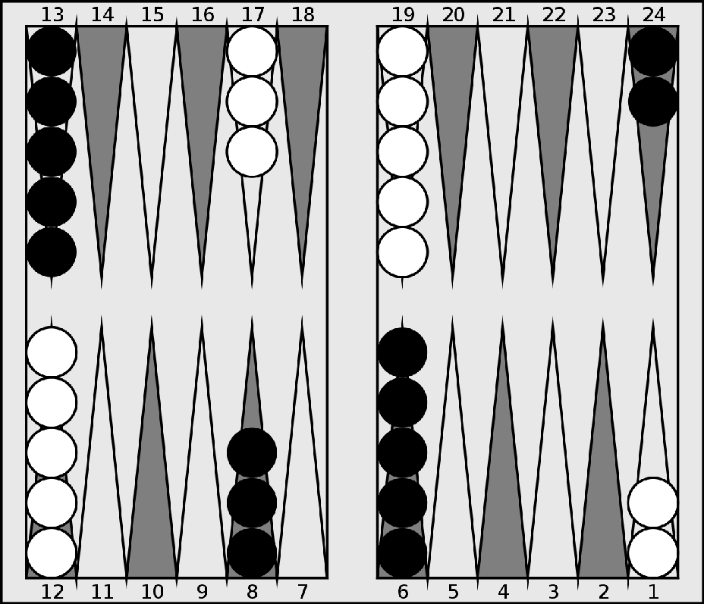
Calibration Step #2
Create all Checkers Containers
Create bounding box around each red triangle (12)
Sort bounding boxes top-to-bottom, left-to-right (6 top, 6 bottom)
Calculate bounding box for all black rectangles (12)
Calculate bounding box for the bar (1)
The order is reverse as the camera opposes the player

Slide 14
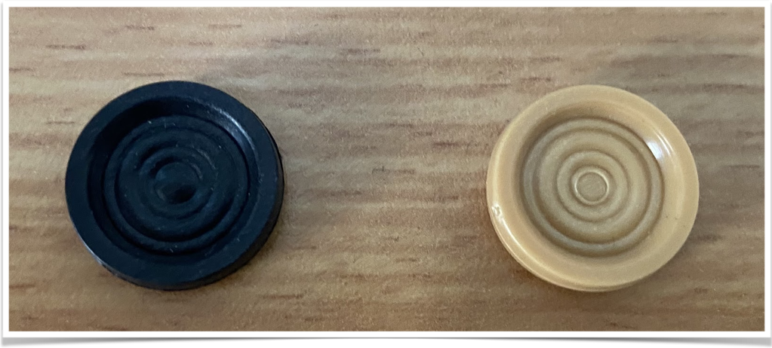
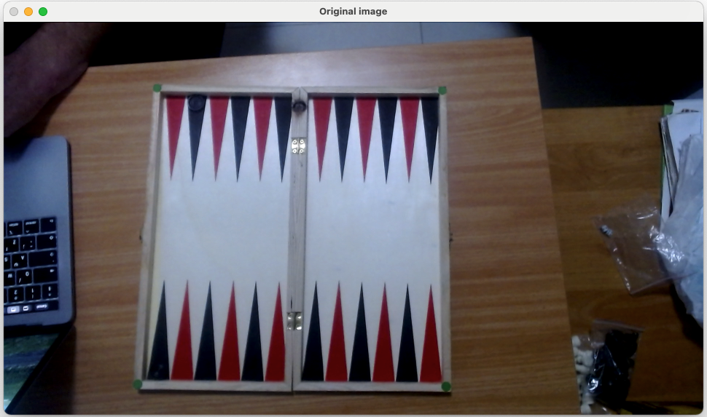


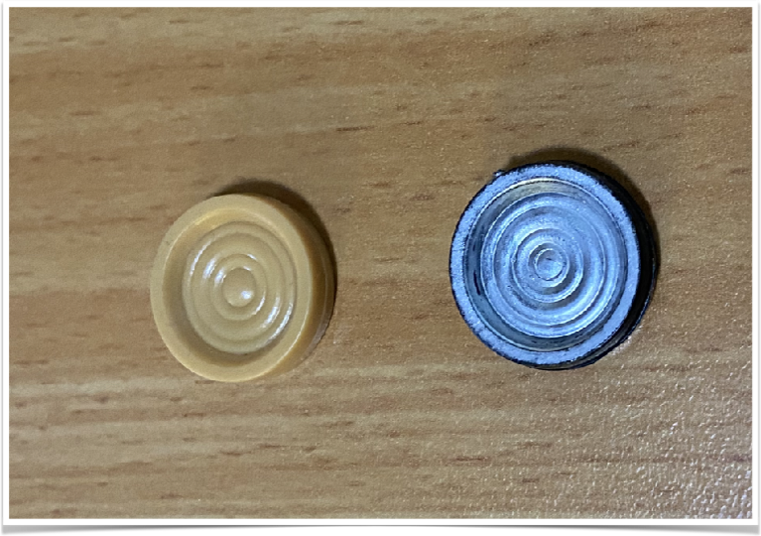
During the Game: Detect Current Board Status
Again, color issues!
Can you spot the 2 black checkers on the board?
Black player
White player

Slide 15

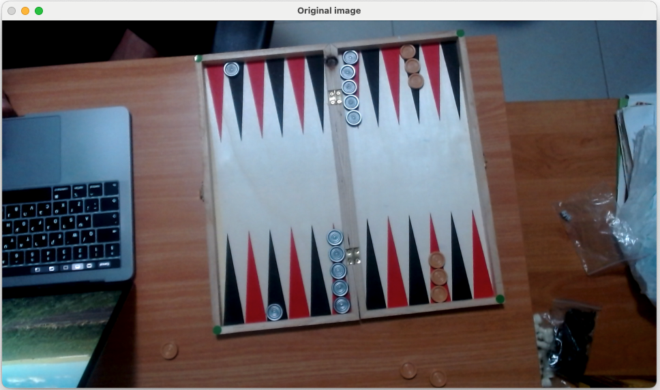


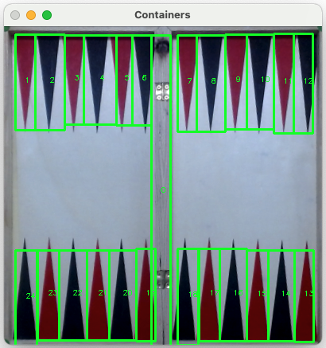

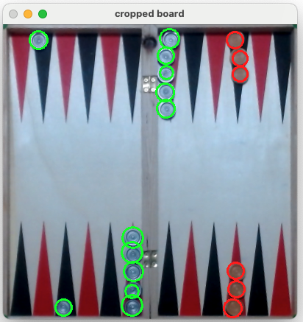

Detect Current Board Status
Apply 2 HSV filters (caramel & silver)
Erosion and dilation
Hough circles transform
Associate each circle’s center to it’s respective checker container box

Slide 16
Summary
It was a great experience in realizing the challenges of computer vision
There is a real challenge in developing robust computer vision software
We liked the outcome
Backgammon is a fun game to play
Good user experience with adequate performance
Need good lighting conditions!

